Slide 1

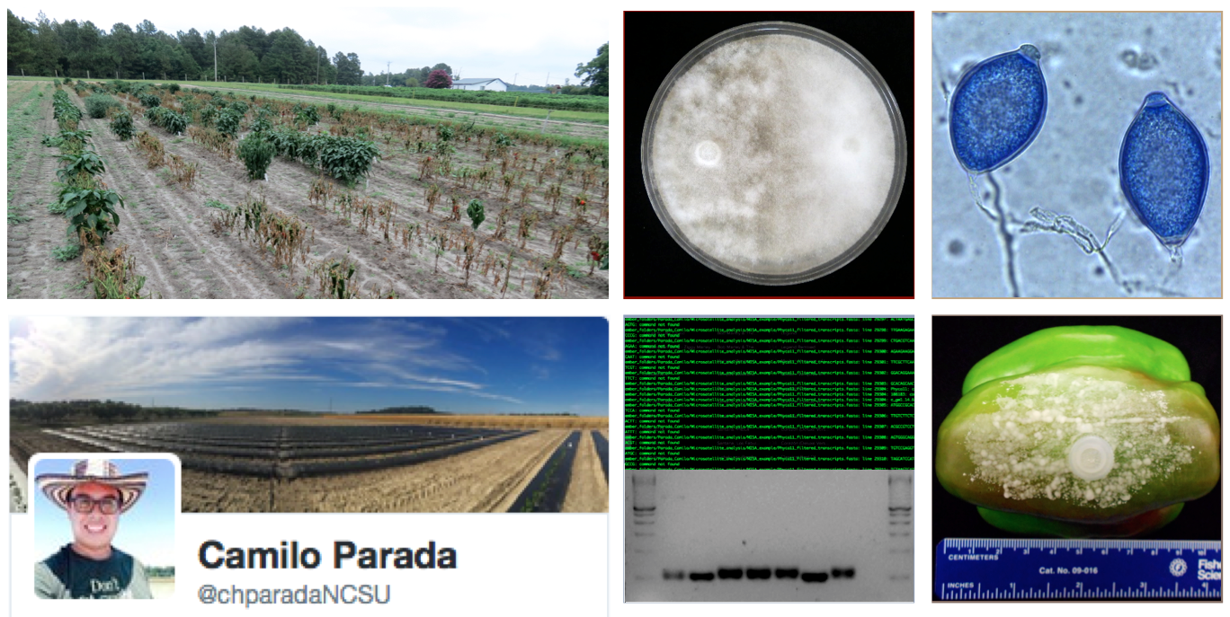
Development of microsatellites from whole-transcriptome sequences in Phytophthora capsici for population studies
December 9, 2015
Camilo Parada
Lina Quesada Ocampo
@chparadaNCSU

Slide 2
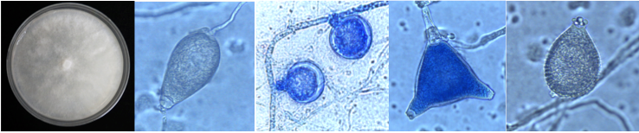
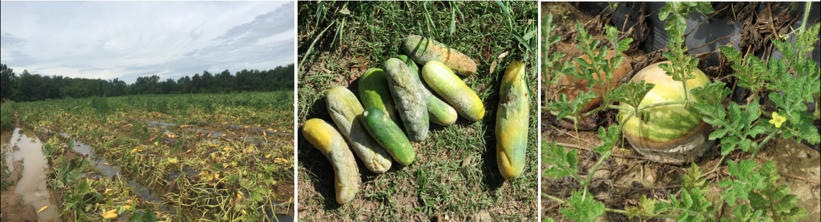
Phytophthora capsici
Important disease of worldwide occurrence in cucurbits, solanaceous, and other vegetable crops
Cause of Phytophthora crown, root and fruit rot
Disease is favored by warm and wet conditions
Sexual reproduction results in high genetic diversity and new isolates that can overcome control strategies
Notes:
Increase incidence may due to extreme weather events
Most of the vegetables in NC are susceptible
Increase resistant to fungicides and resistant cultivars

Slide 3
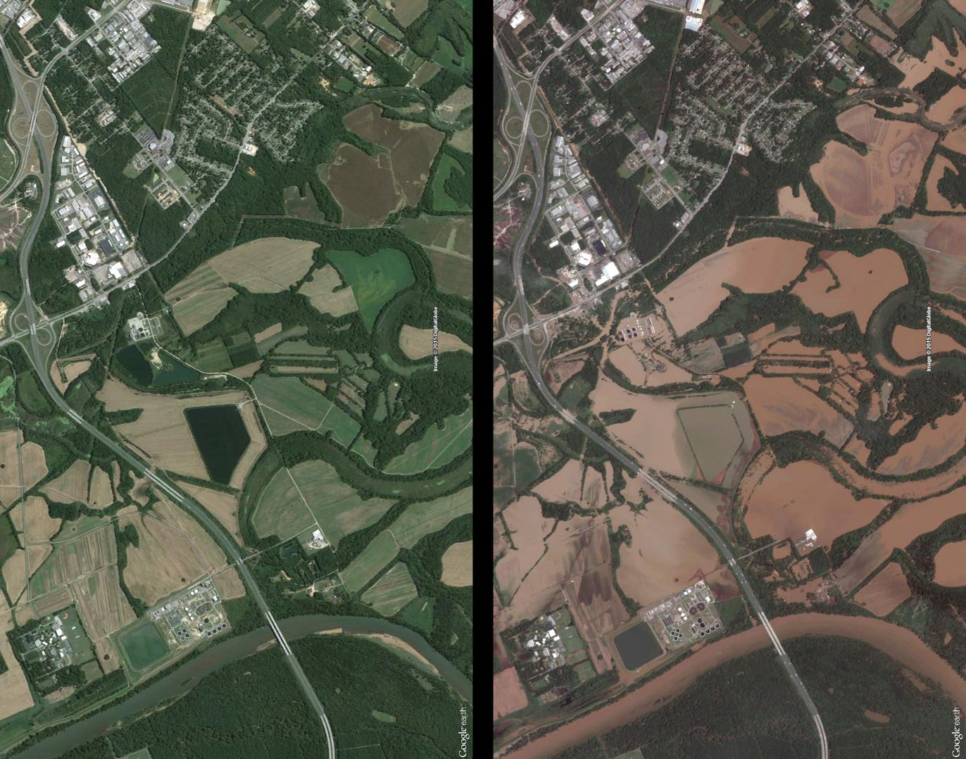
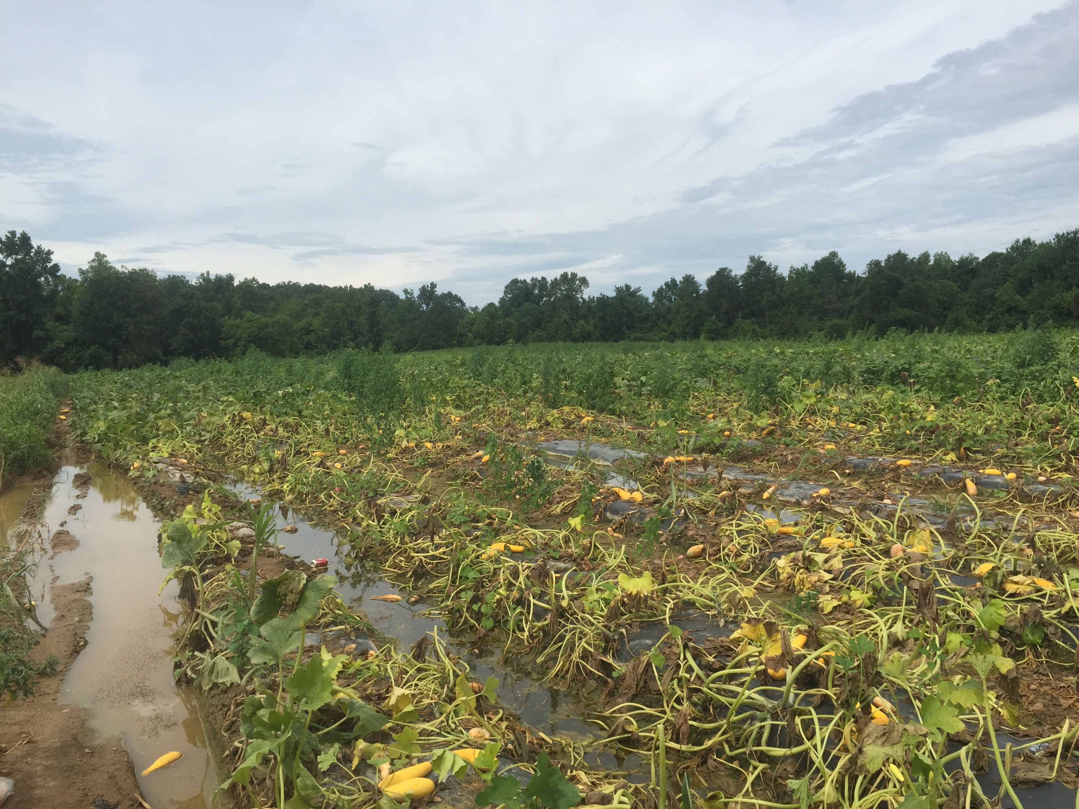
Infested water has resulted in rapid spread
Heavy rains, flooding and culls
Unknown population structure in NC
Preliminary phenotypic data show differences in virulence and fungicide resistance
11 Oct 15 12 Oct 15
Flooding in NC after heavy raining

Slide 4
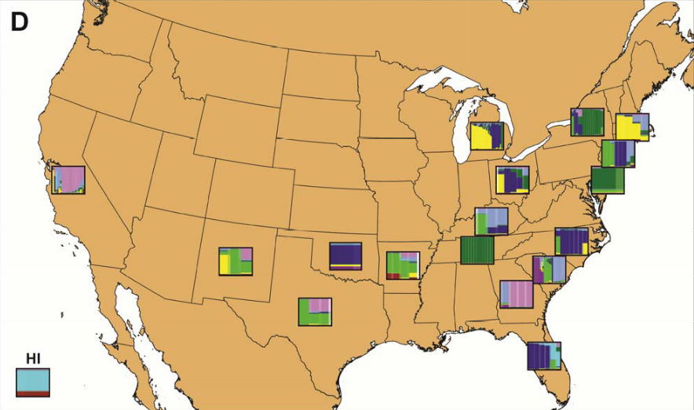
Population Genetics
High genetic diversity at a global scale
Genetic stratification by geography and host
(no wind dispersal = isolated populations)
Understanding local population is important for effective disease management
(Quesada-Ocampo et al. 2011)
Notes:
A recent study using hundreds of isolates from locations world- wide and diverse hosts has confirmed the high genetic diversity of P . capsici at a global scale and detected the presence of population structure by geography (Fig. 5D) and by host (98).
This was in agreement with previous investigations documenting differences in pathogenicity of isolates from cucurbitaceous and solanaceous hosts (102), and that P . capsici is not wind dispersed, creating geo- graphically isolated subpopulations (46). Finding genetic stratifica- tion in P . capsici populations by geography and host highlight the importance of including isolates from different subpopulations that represent the genetic variation in P . capsici for development of diagnostic tools, fungicides, and host resistance. Management can be tailored to control local populations of P . capsici; nevertheless, this approach requires a detailed knowledge of regional pathogen population structure and distribution.
of including isolates from all detected clusters that represent the genetic variation in P . capsici for development of diagnostic tools, fungicides, and host resistance

Slide 5

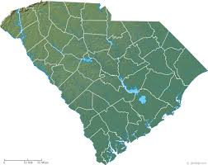
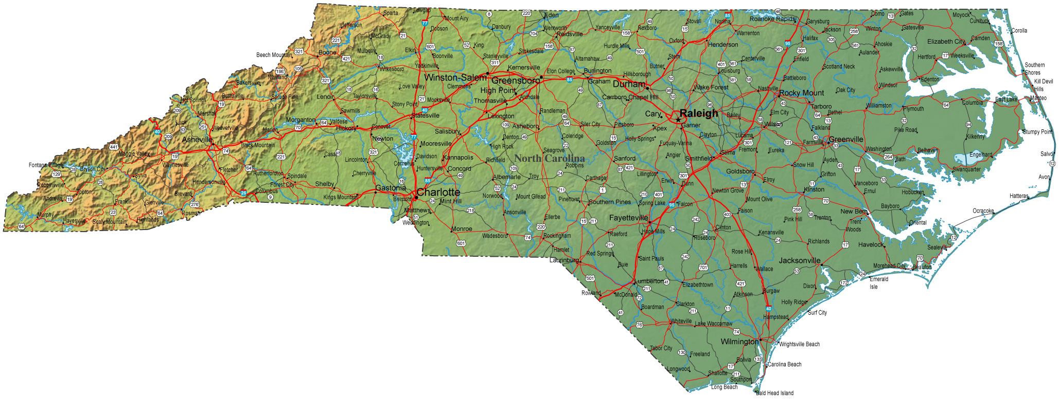
Project Objectives
Collect isolates from NC and SC in 2014 - 2016
Phenotypic characterization (hosts, regions, mating type, mefenoxam sensitivity, virulence on fruit, field and greenhouse)
Marker development – SSRs from transcriptome
Diversity assessment of Microsatellite markers
Characterize population structure in NC to improve management strategies

Slide 6
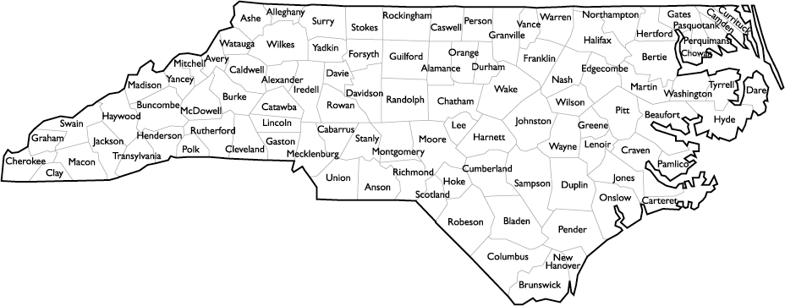

P. capsici collection: North Carolina

Slide 7
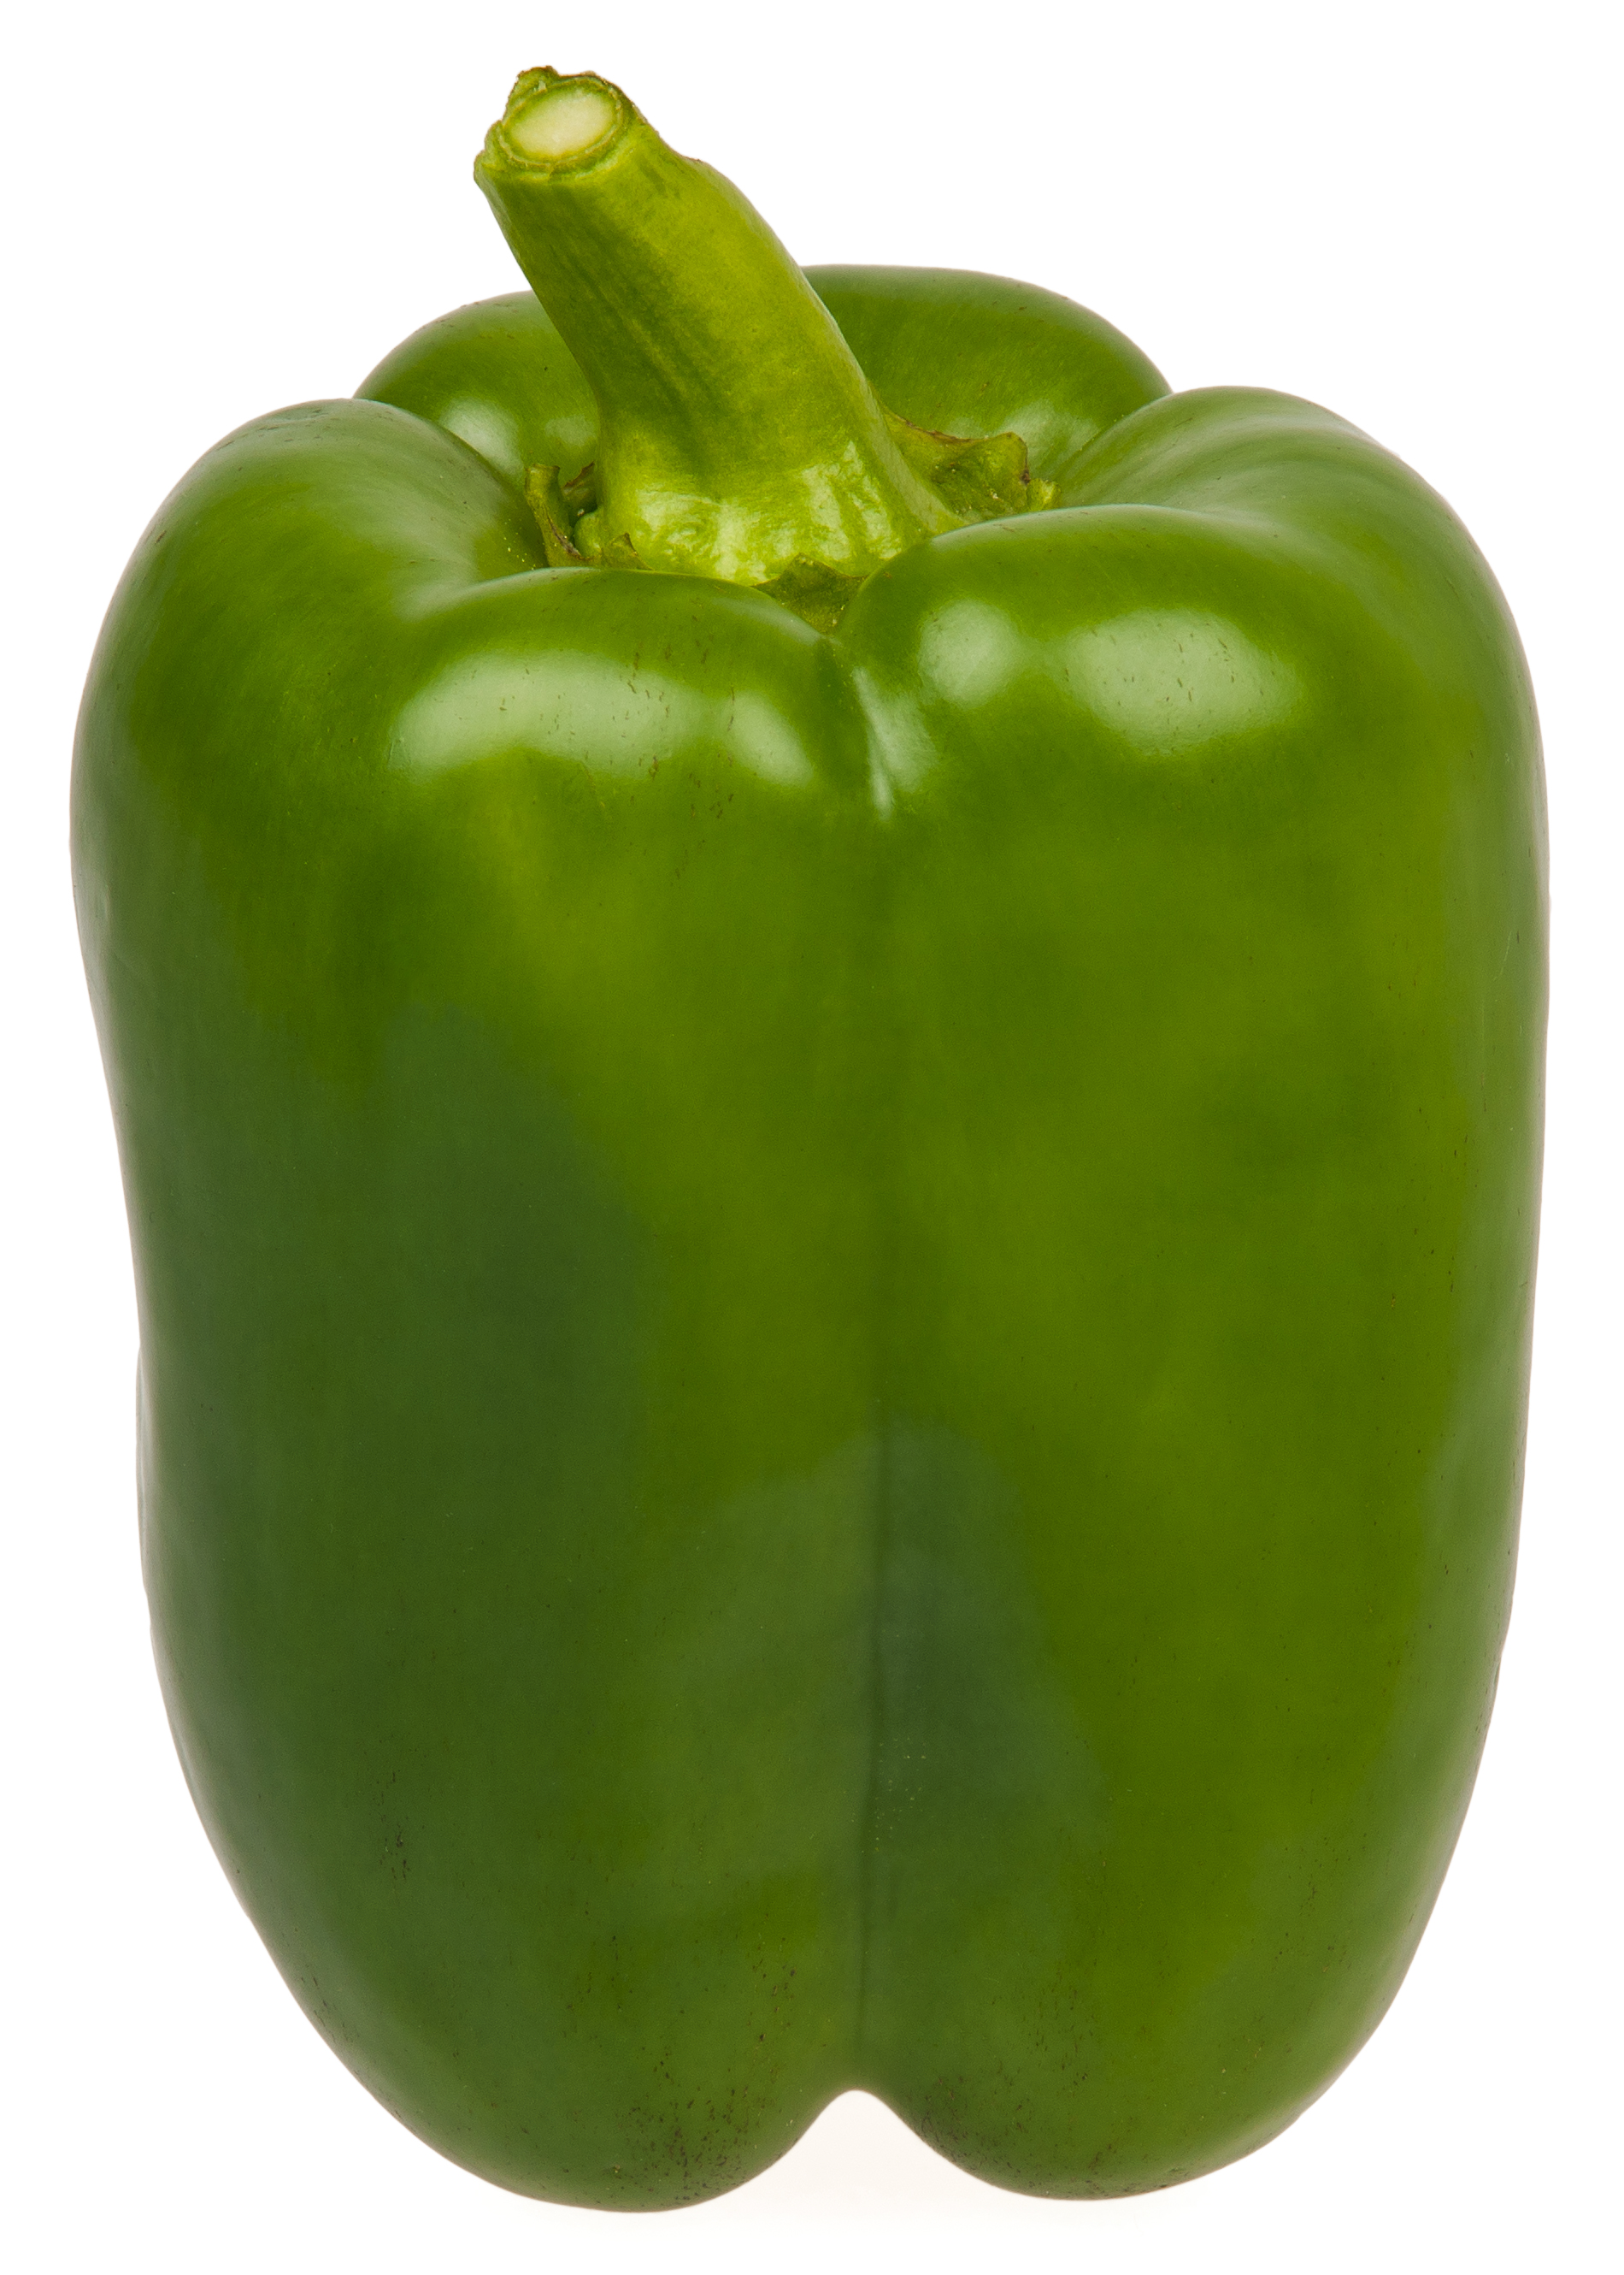
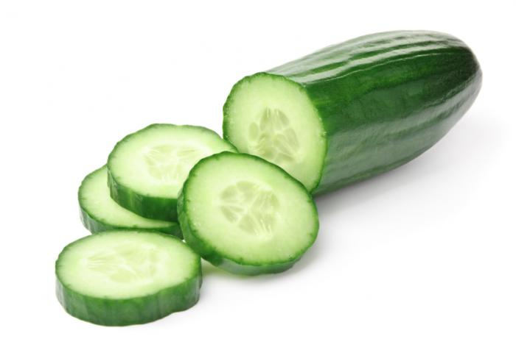
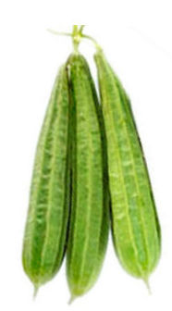
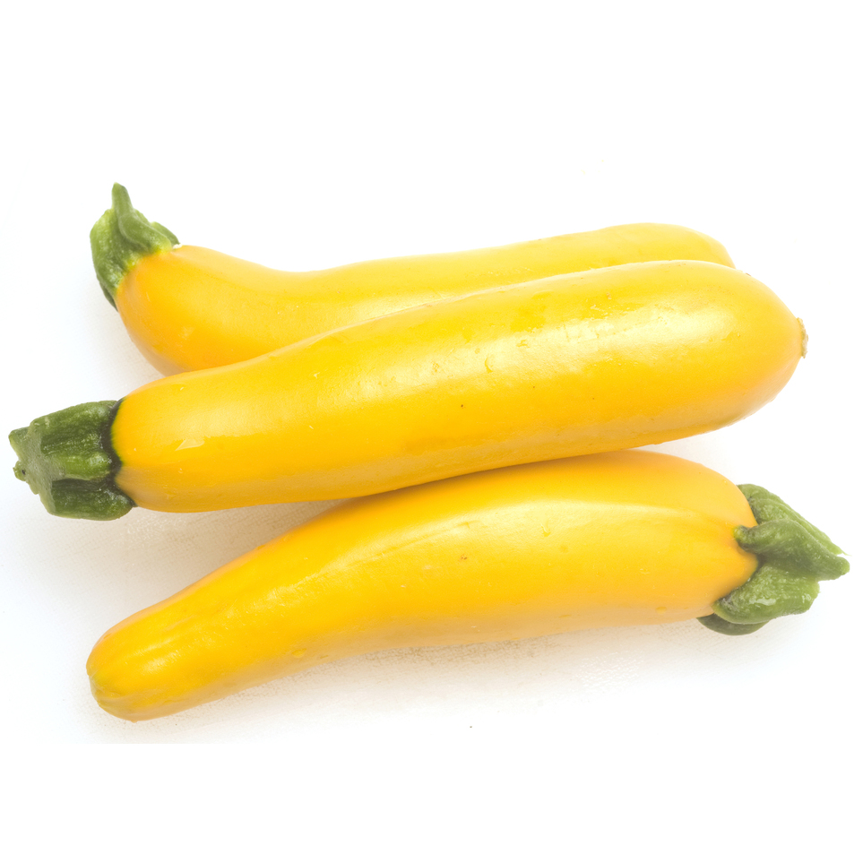
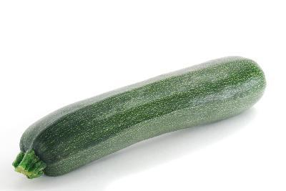
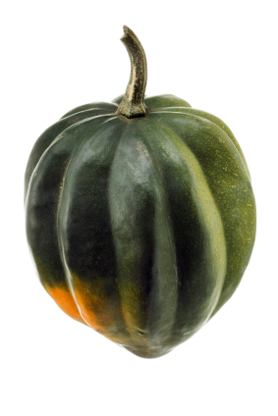
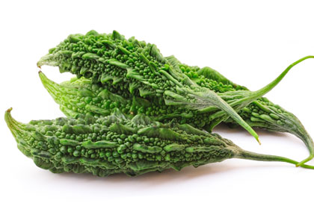
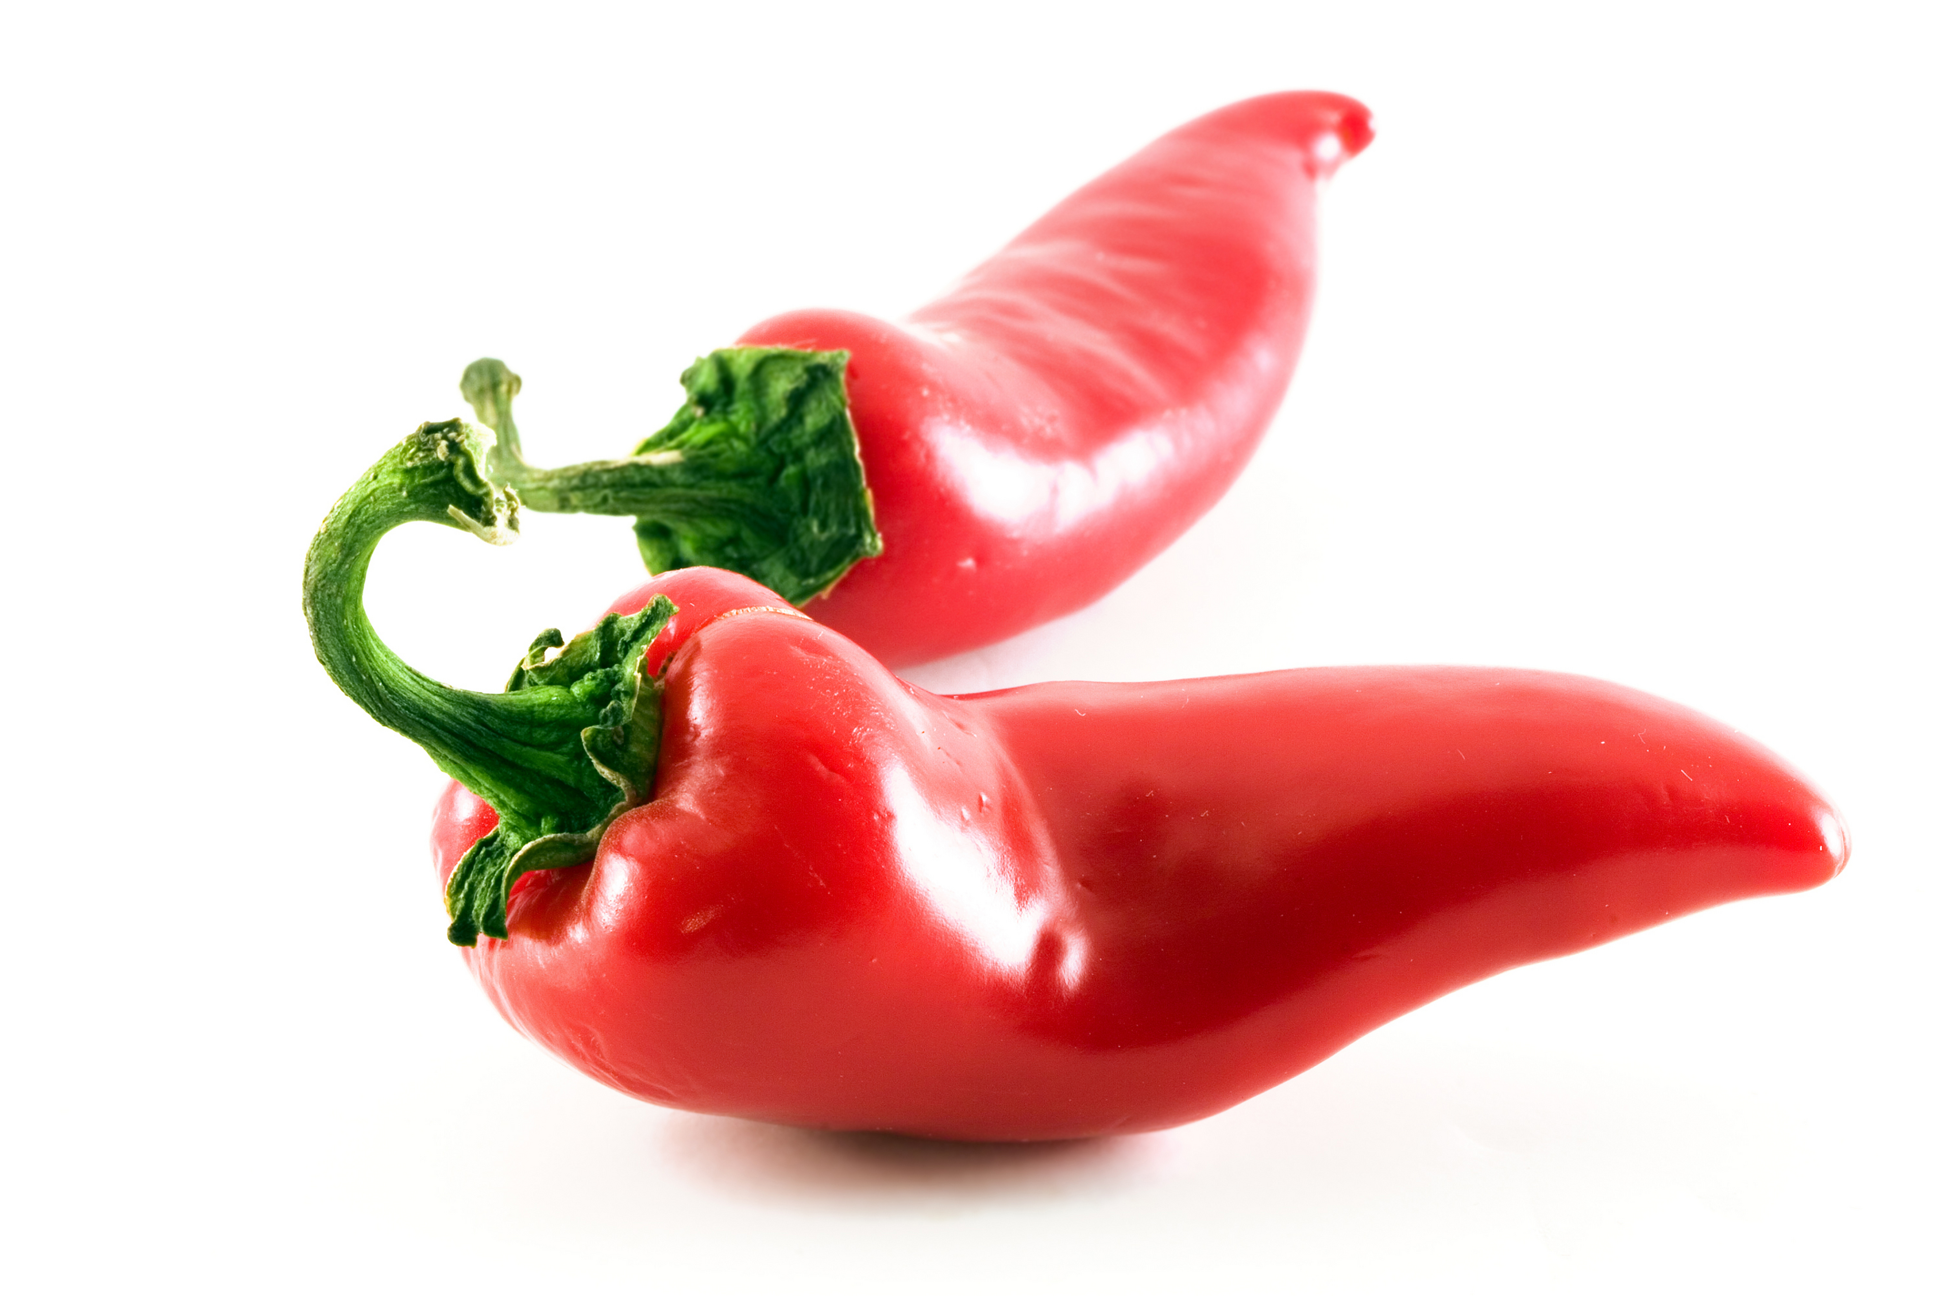
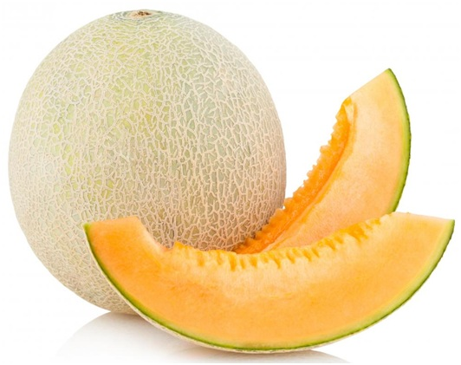
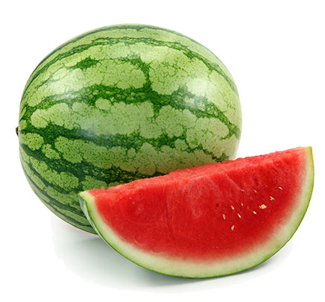
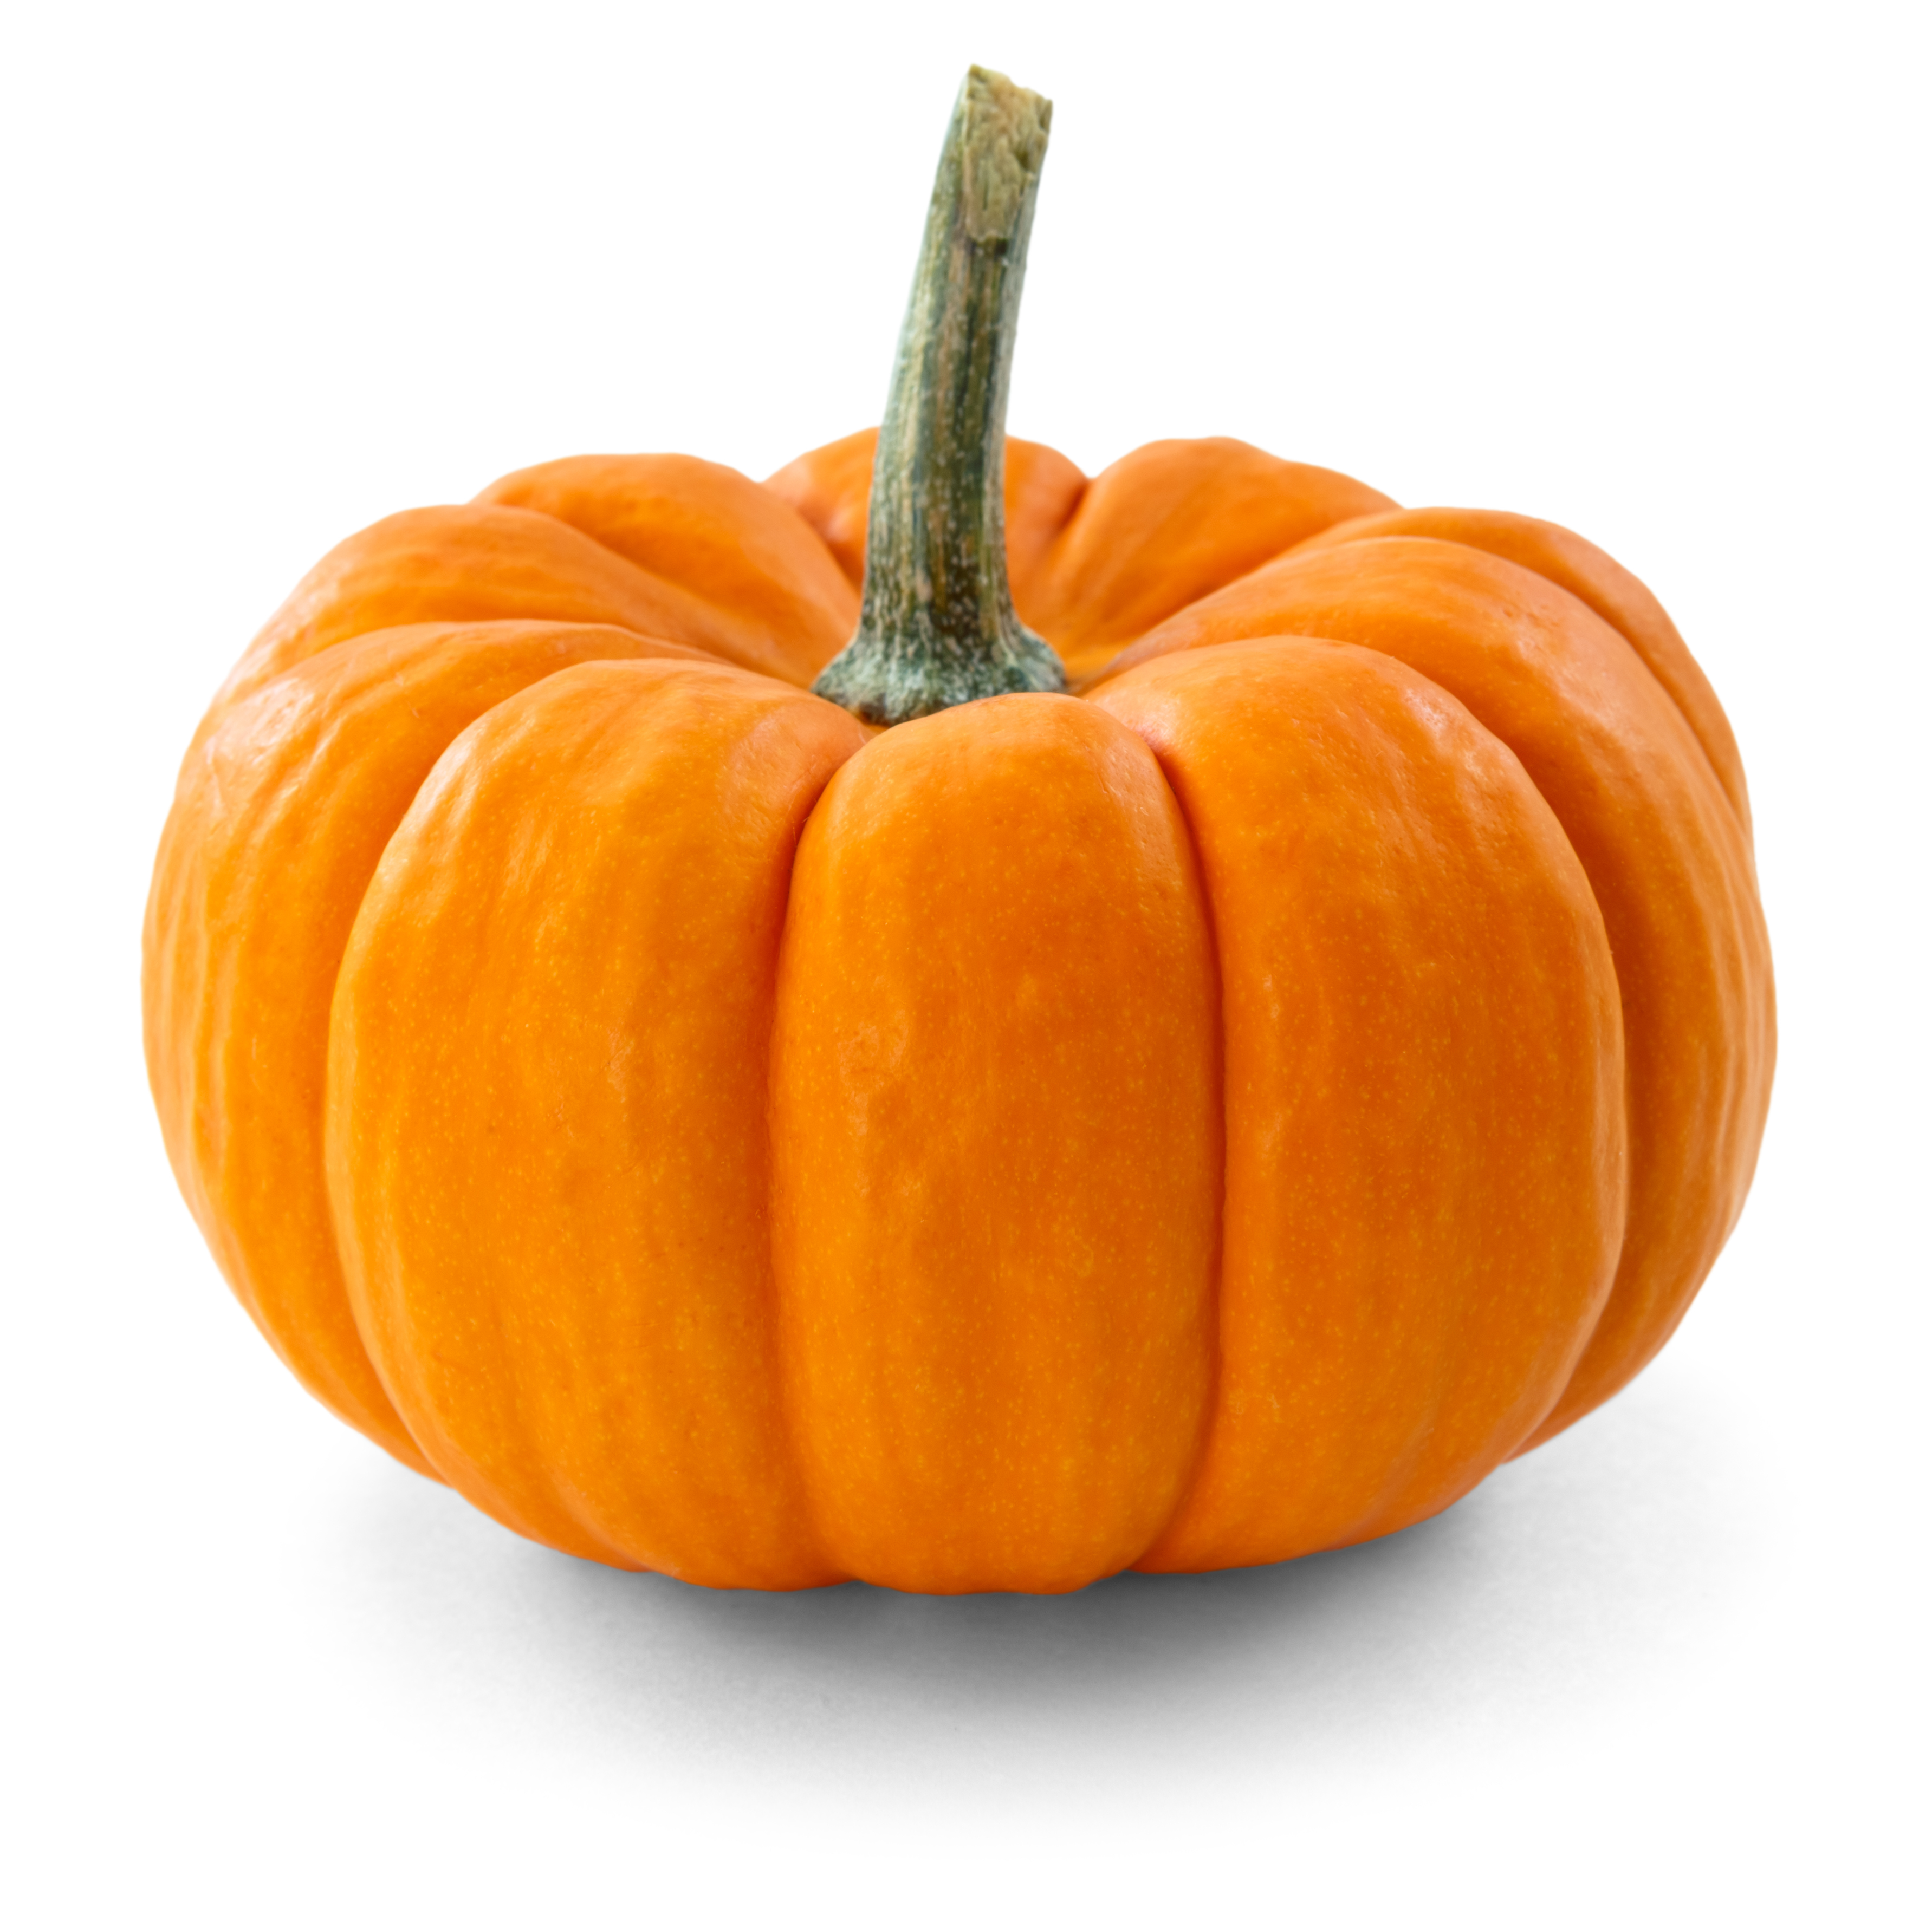
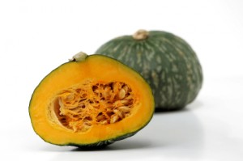
P. capsici collection: Host

Slide 8
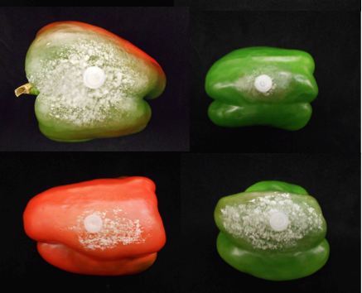
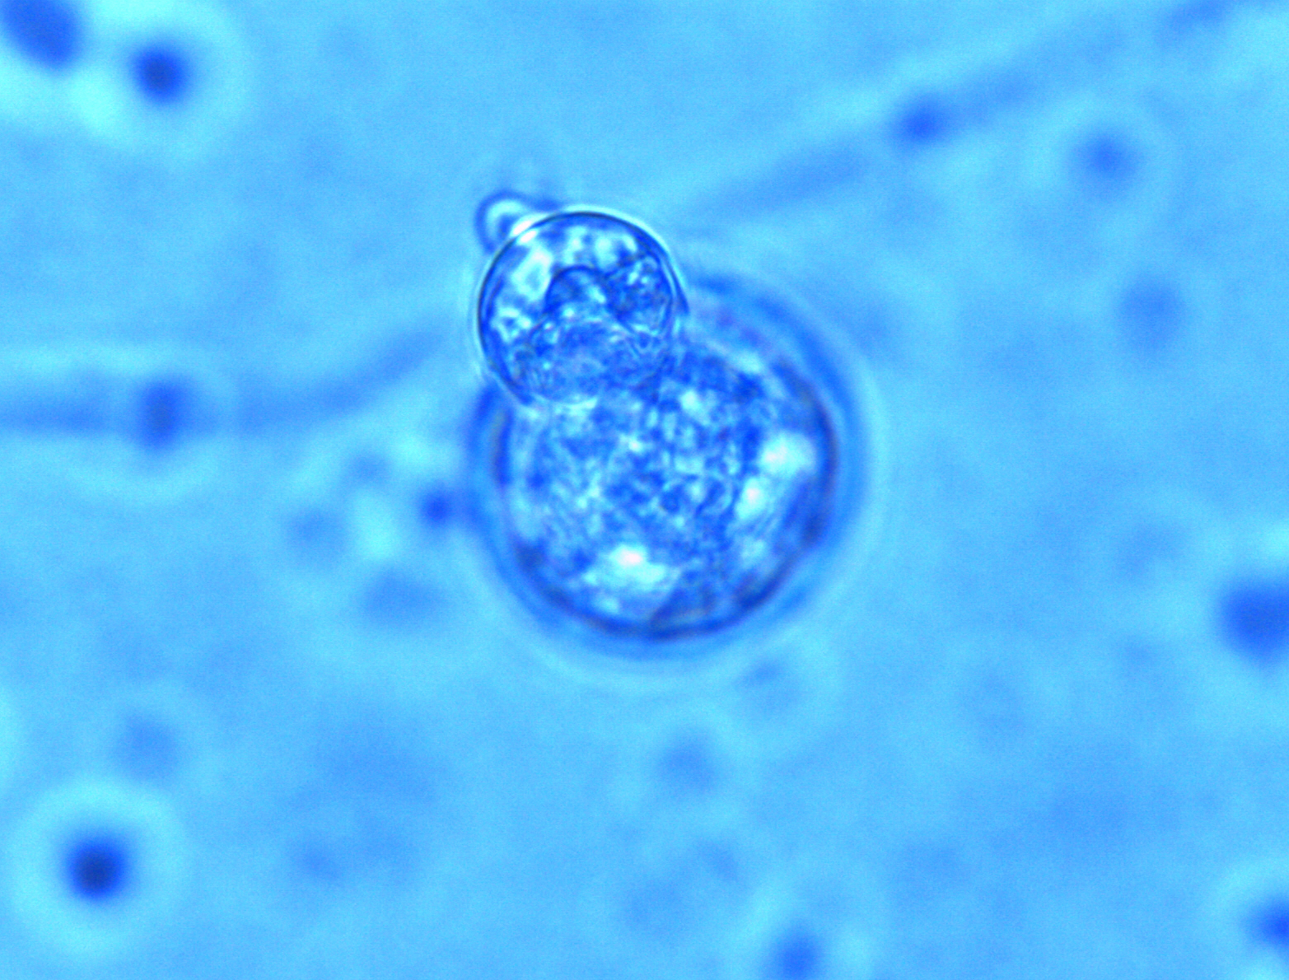
Isolate Virulence
Mating type
Mefenoxam sensitivity

Slide 9
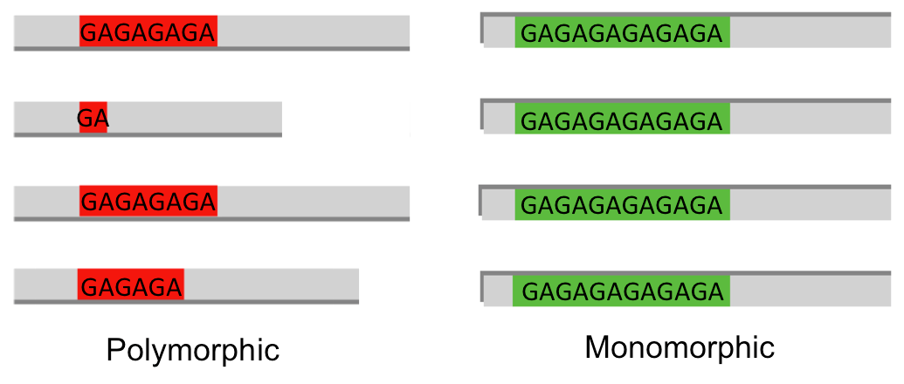
Microsatellites or Simple Sequence Repeats
SSRs are short DNA sequences consisting of tandemly repeated units, generally 1 – 6 base pairs in length
SSRs can be found in either non-coding or coding regions
SSRs from coding regions are more likely to be conserved across species, high level of transferability to closely related species
Notes:
Accesible, reproducible, validation of sequencing data

Slide 10
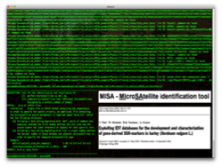
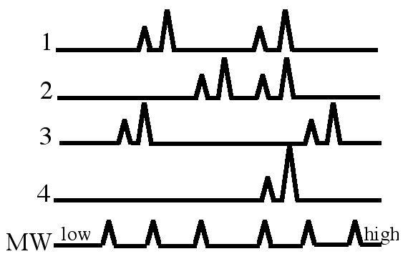

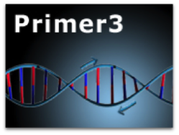
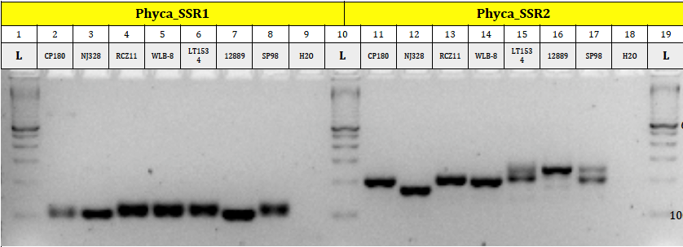
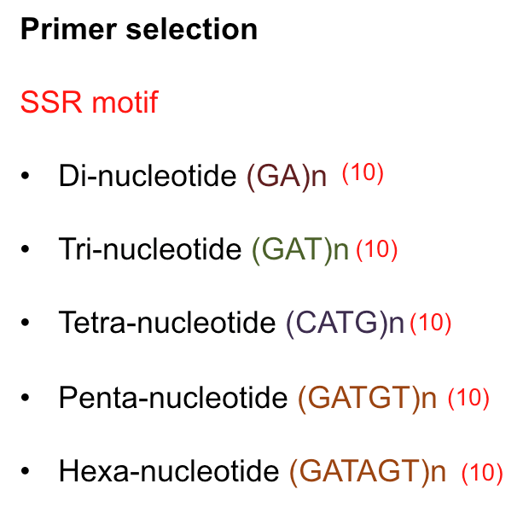
Transcriptome data
SSR identification
(MISA)
Primer design
and
selection
Validation
&
Determination of polymorphism
Microsatellite discovery pipeline
P. capsici LT1534 v11.0
Obtain P. capsici isolates
Grow, filtrate, and lyophilize mycelia
Extract high quality and quantity DNA
PCR and validation by agarose gel
Fragment analysis to confirm polymorphism

Slide 11
Distribution of SSRs
<
P. capsici exhibit the lowest SSR density and abundance
Notes:
So far, I do not have any strongly supported explanation for this. And I was wondering if you can

Slide 12
Frequency distribution by motif length and number of repeats
Notes:
Pattern

Slide 13
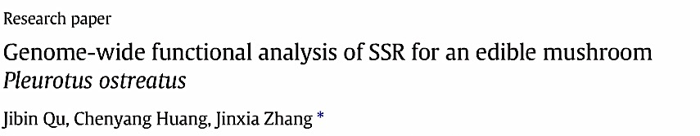
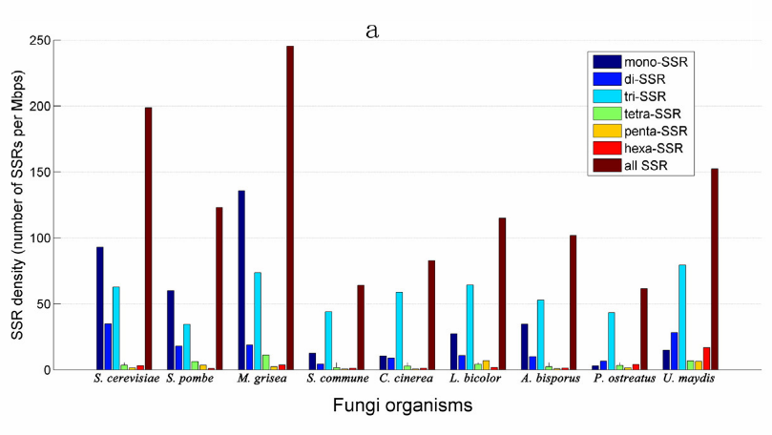
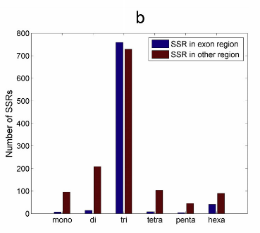
Similarly to previous studies, frequency of trinucleotide SSRs was larger than rest of SSRs.
Trinucleotide SSRs may affect the protein structure or play a role in gene regulation and transcription
Notes:
We are seen a pattern
Codons encoding hydrophilic amino acids (Lys: AAG) are better tolerated, and these trinucleotide motifs in coding regions likely confer a survival value to remain in a population

Slide 14
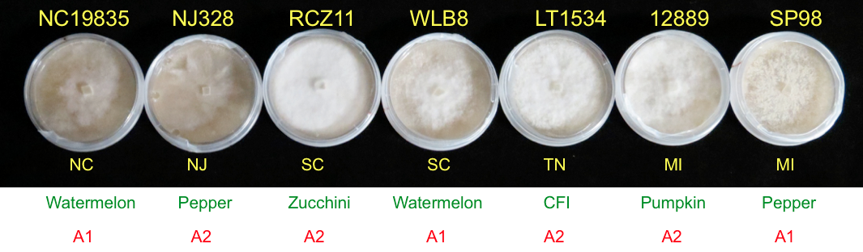
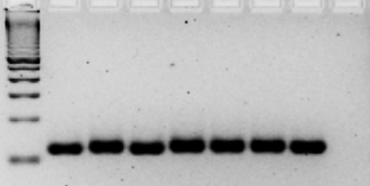
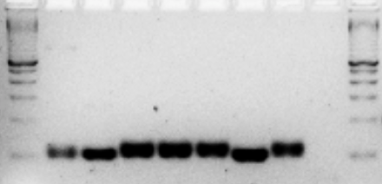
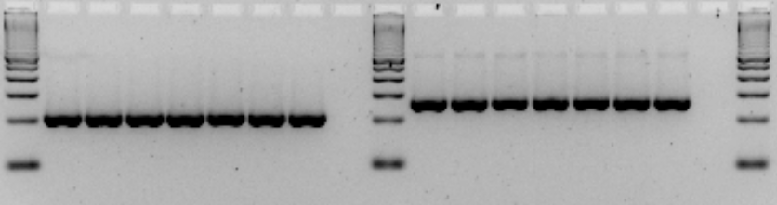
SSR validation
Polymorphic (17)
Monomorphic (31)
L
NC19835
NJ328
RCZ-11
WLB-8
LT1534
12889
SP98
W
L
NC19835
NJ328
RCZ-11
WLB-8
LT1534
12889
SP98
W
L
L
NC19835
NJ328
RCZ-11
WLB-8
LT1534
12889
SP98
W
L
NC19835
NJ328
RCZ-11
WLB-8
LT1534
12889
SP98
W
L
Notes:
Monomorphic SSRs due to Low levels of variability due to highly conserved regions

Slide 15
Summary Statistics and Diversity Measures
SSR | Motif | Alleles | He | Ho | PIC
SSR36 | (AAG)6 | 126, 129 | 0.490 | 0.571 | 0.3698
SSR1 | (CAG)4 | 112, 145, 178, 211, 217, 262 | 0.776 | 1.000 | 0.7406
SSR39 | (AAG)7 | 248, 251, 254, 257, 287 | 0.714 | 1.000 | 0.6707
SSR27 | (GA)6 | 350, 352, 354, 358 | 0.622 | 0.571 | 0.5474
SSR37 | (AGC)6 | 262, 272, 274, 280 | 0.663 | 1.000 | 0.6003
SSR18 | (CAG)5 | 121, 124, 127, 130, 133, 151, 157, 169, 178 | 0.857 | 0.857 | 0.8415
SSR31 | (AGC)4 | 178, 181 | 0.245 | 0.286 | 0.2149
SSR19 | (AAG)6 | 215, 218, 221, 224, 227 | 0.714 | 0.857 | 0.6707
SSR65 | (ACTTCA)4 | 236, 248, 260, 272 | 0.612 | 0.571 | 0.5407
SSR55 | (CCAG)6 | 152, 284, 292, 296, 300 | 0.724 | 1.000 | 0.6853
SSR75 | (TCCTC)3 | 210, 215 | 0.490 | 0.857 | 0.3698
SSR20 | (CACGAC)5 | 112, 124 | 0.408 | 0.571 | 0.3249
Notes:
pectate lyase
Heterozygosity is of major interest to students of genetic variation in natural populations. It is often one of the first "parameters" that one presents in a data set. It can tell us a great deal about the structure and even history of a population. Just for example, very low heterozygosities for allozyme loci in cheetahs and black-footed ferrets indicate severe effects of small population sizes (population bottlenecks or metapopulation dynamics that severely reduced the level of genetic variation relative to that expected or found in comparable mammals). High heterozygosity means lots of genetic variability. Low heterozygosity means little genetic variability. Often, we will compare the observed level of heterozygosity to what we expect under Hardy-Weinberg equilibrium (HWE). If the observed heterozygosity is lower than expected, we seek to attribute the discrepancy to forces such as inbreeding. If heterozygosity is higher than expected, we might suspect an isolate-breaking effect (the mixing of two previously isolated populations).

Slide 16
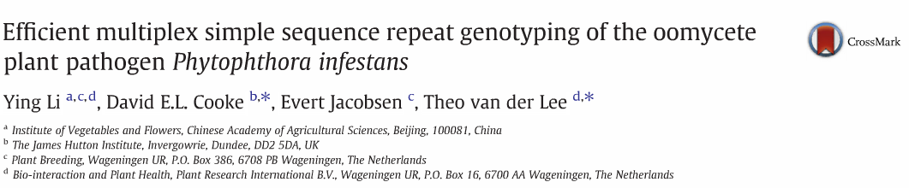
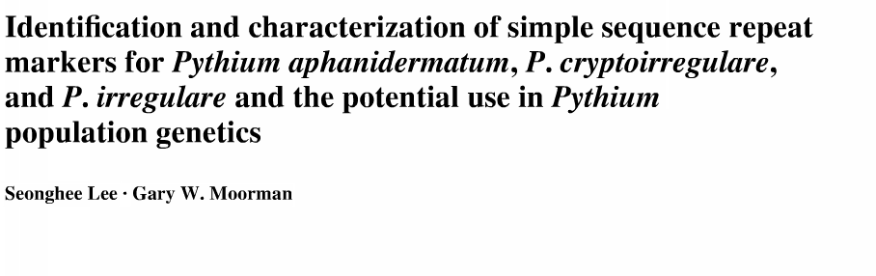
PIC values ranged from 0.21 to 0.84 with a mean of 0.54
PIC values range from 0.19 to 0.78 with a mean of 0.51 in P. infestans
PIC values ranged from 0.375 to 0.553 with a mean of 0.58 in P. irregulare
Notes:
The Polymorphism Information Content (PIC) value is a common- ly used measure of the amount of information one can recover from a genetic marker.

Slide 17
Allele frequency for 7 P. capsici isolates
SSR37 SSR18 SSR19 SSR65
SSR55 SSR1 SSR39 SSR27
Notes:
Allele frequency ranged from 2 to 9 alleles

Slide 18
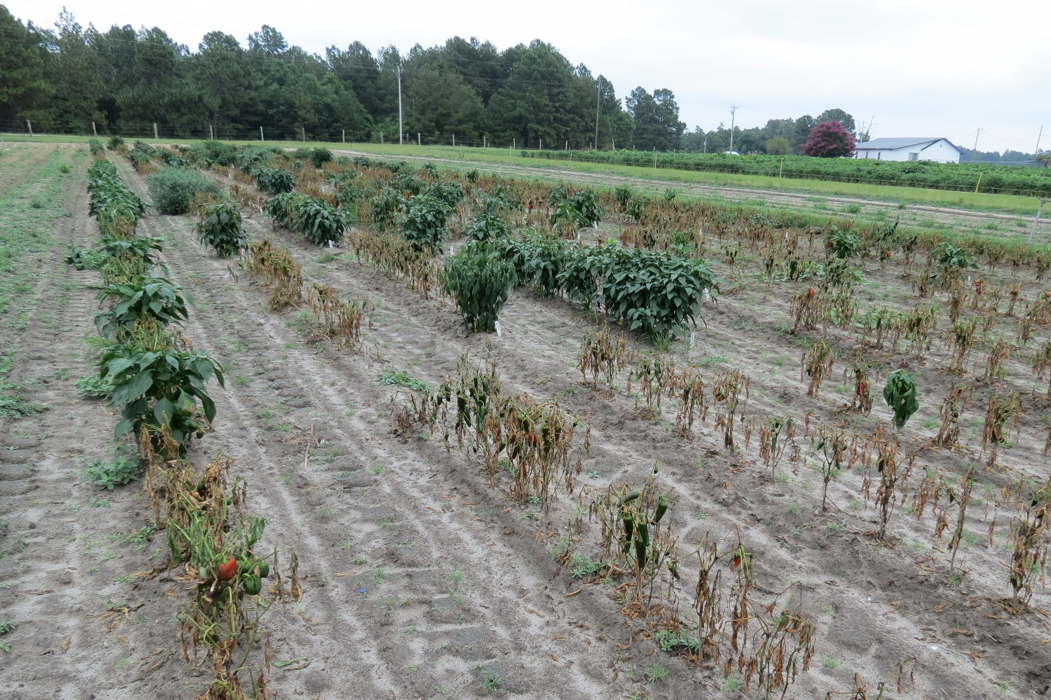
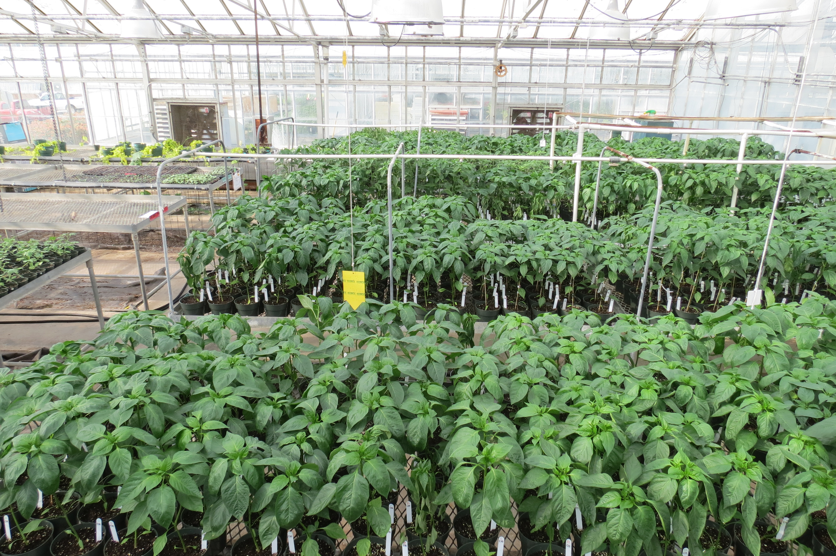
Other research
Evaluating commercial pepper cultivars for resistance to P. capsici
32 pepper lines vs mix of isolates
48 pepper lines vs 3 isolates
Assays of fungicide sensitivity in vitro (Ranman, Ridomil, Presidio..)
Assays to characterize virulence in pepper fruits

Slide 19
Results from field trial
S
T
R
Martha- R showed the highest levels of resistance to the isolates of P. capsici, while Plato, Red Knight and Bastille showed the highest susceptibility.
Notes:
So here you have the results for the field trial, in the x axis you can see the different cultivars that we evaluate and in the y axis the plant death percentage. So we observe this chunk suceptible of cultivars, we also observe some tolerant cultivars. But maybe the most important finding was this cultivar here. Martha-R showed the highest levels of resistance to the isolates.

Slide 20
Results from the GH trial
S
T
R
Notes:
So this are the results for GH trial. At the x axis the Plant Death Percentage and at the y axis the different cultivars that we evaluate. So basically more than of cultivars shown to be susceptible, Archimides, paladin, Ebano R and some experimental seems to be tolerant. Martha – R , Meeting and Intruder showed the highest levels or resistant.

Slide 21
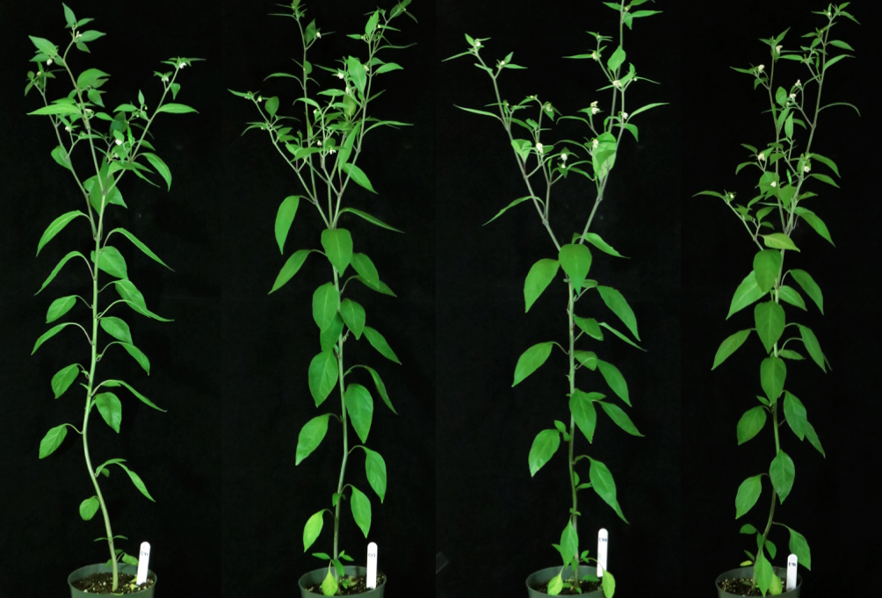
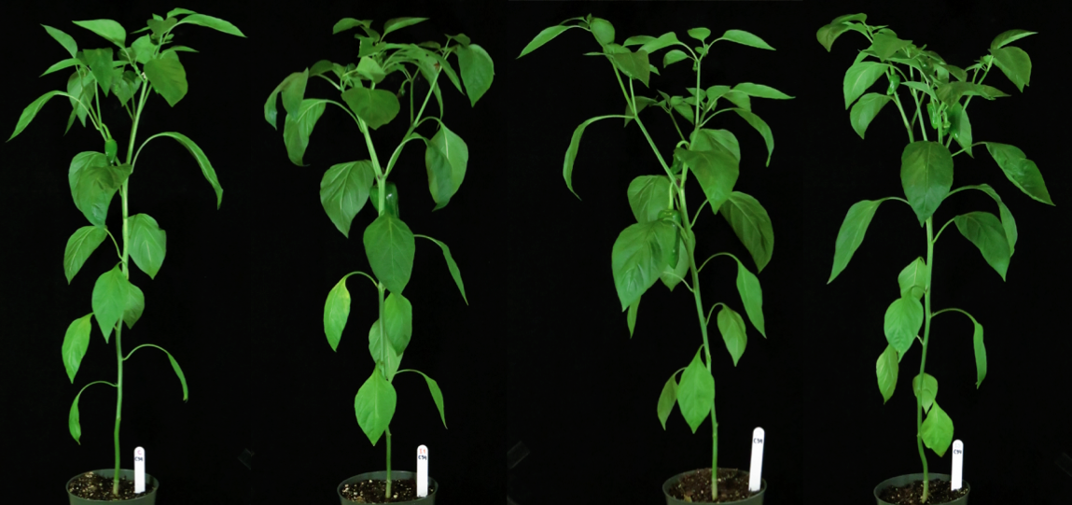
Resistant cultivars
Fidel (Land race)
Martha - R
Control NC21810 MI12889 NCCP3
Notes:
So here you have what we saw in the greenhouse at the end of the trial. This is Fidel (the land race pepper, a wild type pepper without economic value). And Martha –R that seems to be resistant to the different isolates we used to inoculate.

Slide 22
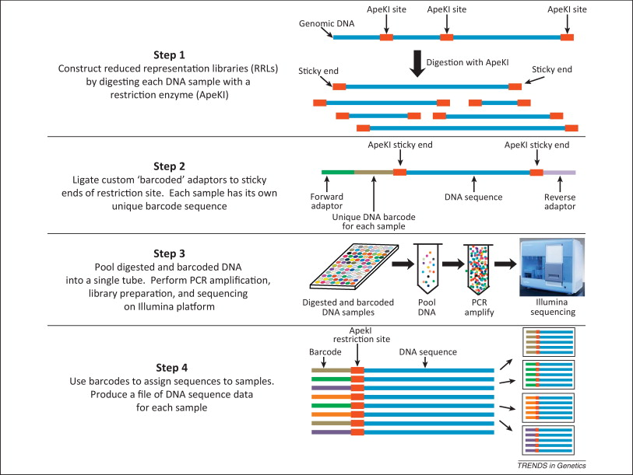
Future work
Use the genotyping by sequencing protocol to obtain SNPs
Determinate population structure of collected isolates from NC

Slide 23



Acknowledgments
The Quesada Lab
Research collaborators:
Dr. David Ritchie
Dr. Shaker Kousik
Dr. Mary Hausbeck
Dr. Anthony Keinath
Isolates
Dr. Jean Ristaino
Dr. Kurt Lamour
Funding:
Notes:
NC agriculture

Slide 24
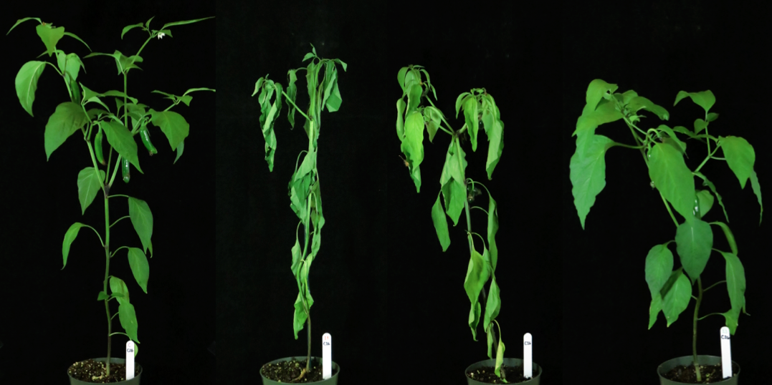

Results
H1653
Control NC21810 12889 NCCP3

Slide 25
Results
Fidel (Land race)
Control NC21810 12889 NCCP3

Slide 26

Results
Marta - R
Control NC21810 12889 NCCP3

Slide 27
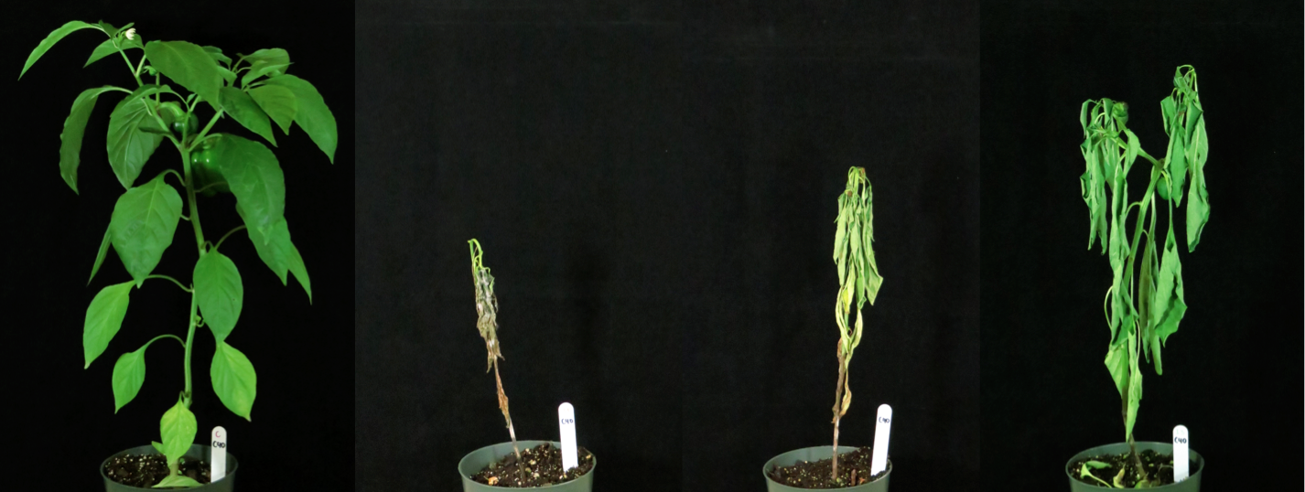

Results
Red Knight
Control NC21810 12889 NCCP3

